Slide 1
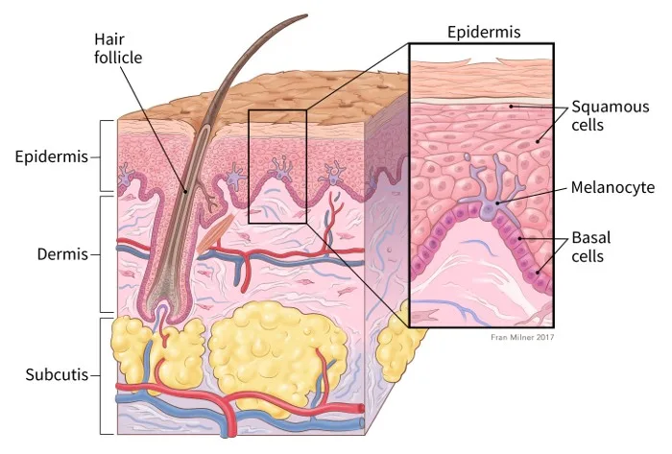
PAX3's Role in Nonsense-Mediated Decay: Implications for Melanoma
Lulu Jiang

Slide 2
Background
PAX3 gene
The PAX3 gene is a member of the paired box (PAX) family of transcription factors, which are essential in regulating cell growth and differentiation.
Normal Conditions:
PAX3 regulate cell growth and differentiation genes and can act as both an activator and repressor of transcription, depending on the target gene and cellular context.
PAX3 in Cancer:
PAX is often found to be overexpressed → downregulate genes that induce apoptosis
Notes:
PAX3 regulates the expression of various target genes involved in cell growth, differentiation, and survival.
In normal cells, PAX3 can act as both an activator and repressor of transcription depending on the target gene and cellular context.
As a transcription activator, PAX3 binds to the promoter regions of specific genes to enhance their transcription.
For example, PAX3 can activate genes that promote cell growth and differentiation, crucial during developmental processes.
As a transcription repressor, PAX3 can inhibit the transcription of certain genes by binding to regulatory regions and preventing the recruitment of the transcriptional machinery.
This repressive action helps maintain cellular homeostasis by ensuring that genes not needed at a particular time are kept inactive.
PAX3 in Cancer:
Its overexpression can lead to the dysregulation of pathways that control cell cycle and apoptosis, aiding in cancer progression.
For instance, PAX3 can downregulate genes that induce apoptosis.
Its overexpression can lead to the dysregulation of pathways that control cell cycle and apoptosis, aiding in cancer progression.

Slide 3
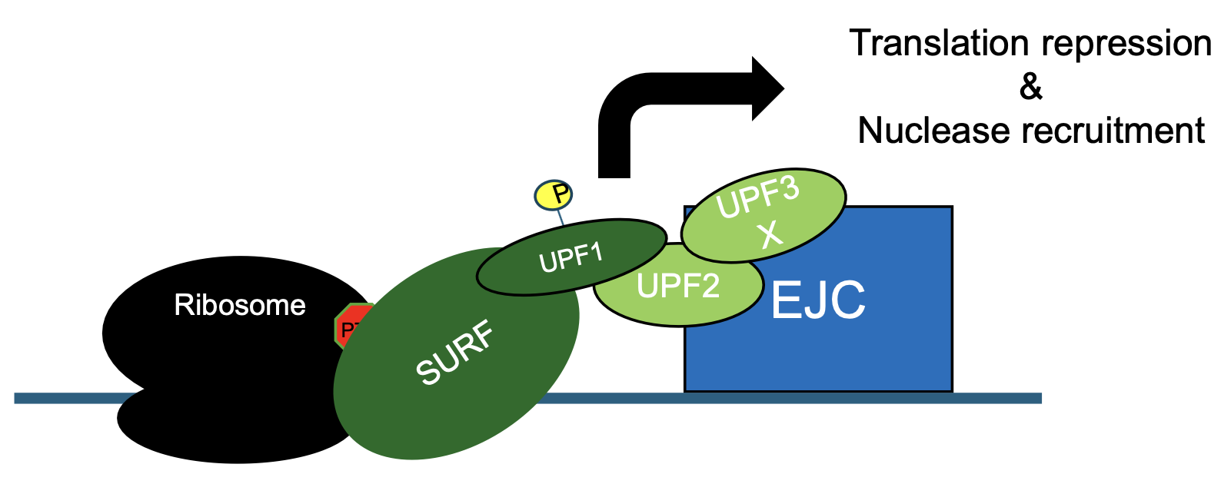
Nonsense mediated decay (NMD)
NMD is an RNA quality control pathway that degrades improperly spliced transcripts containing premature termination codons (PTCs)
It plays a crucial role in maintaining the quality of gene expression and protecting cells from the deleterious effects of mutated mRNAs.
In cancers, NMD suppresses expression of tumor-suppressors and neoantigens
Increased NMD activity associated with reduced survival in some cancers
PTC = Premature Termination Codon
EJC = Exon Junction Complex
Source: Noah
Notes:
NMD activated when a ribosome stalls on a PTC near an exon junction complex (EJC)
Triggers phosphorylation of UPF1, which represses translation and recruits nucleases
Nonsense-Mediated Decay (NMD):
NMD is a surveillance pathway that degrades mRNAs containing premature stop codons, preventing the production of truncated and potentially harmful proteins.
It plays a crucial role in maintaining the quality of gene expression and protecting cells from the deleterious effects of mutated mRNAs.
NMD in Cancer:
In cancers, NMD can suppress the expression of tumor suppressors and neoantigens, which are proteins that can trigger an immune response against cancer cells.
Increased NMD activity is associated with reduced survival in some cancers, as NMD may facilitate the survival and proliferation of cancer cells by degrading mRNAs that encode tumor-suppressing proteins.

Slide 4
Unmet Needs
Unclear Role of PAX3 in NMD:
Current cancer therapies don't target NMD mechanisms
PAX3's influence on NMD could be a novel therapeutic avenue
Research Gaps: Need to understand if PAX3 affects NMD directly or indirectly
Understanding how PAX3 modulates NMD could reveal new aspects of its function in cancer biology.
Notes:
Why this is important:
PAX3 is known to be involved in various cellular processes, including gene regulation.
NMD is a critical quality control mechanism in cells.
Understanding how PAX3 interacts with NMD can reveal new insights into gene regulation and potentially disease mechanisms.
Direct vs. Indirect effects: a) Direct effect would mean:
PAX3 directly interacts with components of the NMD machinery.
PAX3 directly regulates the expression of key NMD factors.
b) Indirect effect would mean:
PAX3 influences NMD through intermediate factors or pathways.
PAX3 alters cellular conditions that then affect NMD efficiency.

Slide 5
Hypothesis and Research questions
General Hypothesis: PAX3 is having an effect on nonsense-mediated decay (NMD).
Research Questions:
How is PAX3 affecting NMD?
Two main hypotheses:
By altering splicing of transcripts to increase the proportion of transcripts that will then be targeted by NMD
Due to NMD activity being increased
Is it possible that both mechanisms are occurring simultaneously?
Notes:
Main Question: How does the PAX3 gene affect a process called nonsense-mediated decay (NMD)? NMD is like a quality control system in cells. It finds and destroys faulty genetic messages before they can cause problems.
the general hypothesis is that pax3 is having an effect on nonsense mediated decay. so our general hypothesis is that pax three is having an effect on nonsense mediated decay. And then we're getting into like asking sort of like different, more granular questions about that.
asking one of the general questions about like NMD is like whether these transcripts that are being down regulated, the changes we're seeing in NMD is due to NMD activity being increased or changes in splicing to increase the proportion of transcript that will then be degraded by NMD. for that we're gonna do splicing analysis looking at two sets: siScramble vs siPAX3 knockdown and then the GFP and PAX3 in H2O groups, looking to see what splicing changes happen there. we're interested in seeing the types of splicing, intro retention or exon skipping.
PAX3 might change how genes are spliced: a) What this means:
PAX3 could influence the splicing machinery or splicing factors.
This could lead to alternative splicing of certain genes.
The resulting mRNA transcripts might be more likely to contain features that trigger NMD.
b) How this would work:
PAX3 might regulate genes involved in splicing.
It could alter the expression of specific splicing factors.
This could lead to more exon skipping or intron retention events.
c) Consequences:
More mRNAs with premature termination codons (PTCs) or long 3' UTRs.
These features often trigger NMD.
Result: Increased degradation of certain transcripts via NMD.
d) Implications:
This would be an indirect way for PAX3 to influence gene expression.
It could affect a broad range of genes, not just direct PAX3 targets.
PAX3 might directly make the NMD process work harder: a) What this means:
PAX3 could directly influence the activity or efficiency of the NMD machinery.
This could lead to increased degradation of NMD-sensitive transcripts.
b) How this would work:
PAX3 might upregulate key NMD factors (e.g., UPF1, UPF2, UPF3).
It could enhance the activity of NMD components through direct or indirect interactions.
PAX3 might influence cellular conditions to favor NMD activity.
c) Consequences:
Increased efficiency of NMD in detecting and degrading target transcripts.
Potentially faster or more complete degradation of NMD-sensitive mRNAs.
d) Implications:
This would represent a more direct role for PAX3 in post-transcriptional regulation.
It could affect the overall stability of many transcripts in the cell.

Slide 6
Methods / Plan

Slide 7
PAX3 and NMD-targeted transcripts
Method for separating transcriptional and NMD-based RNA regulation: Cycloheximide (CHX) treatment
CHX inhibits ribosome function, inhibiting PTC NMD and increasing abundance of NMD-targeted transcripts
Transcripts downregulated via NMD will increase after CHX, transcripts downregulated via transcriptional regulation will NOT.
Protein synthesis
NMD
NMD-targeted RNA
CHX
Protein synthesis
NMD
NMD-targeted RNA
Huth, Michelle, et al., Genes Dev 36:1-20 (2022)
Notes:
Cycloheximide (CHX) is a protein synthesis inhibitor. It prevents the formation of new proteins in cells.
NMD requires ongoing protein synthesis to function properly.
When CHX is applied, it stops new protein synthesis, which in turn inhibits NMD.
This inhibition of NMD can lead to the stabilization of mRNAs that would normally be degraded.
CHX treatment allows researchers to distinguish between transcriptional effects of PAX3 (which don't require new protein synthesis) and post-transcriptional effects (which do require new protein synthesis, including NMD).

Slide 8
Study Design
Using cell culture models with PAX3 manipulation
Analyzing RNA sequencing data to study gene expression and splicing
Employing cycloheximide treatment to isolate direct effects
Cycloheximide (CHX) Treatment
Comparison groups: GFP vs PAX3 overexpression, with/without cycloheximide
GFP
H2O
P3-HA
GFP
CHX
P3-HA
Notes:
Cycloheximide (CHX) Treatment(transfected with media for 48 hours and mix chx in water and marinade for 4 hours)
Comparison groups: GFP vs PAX3 overexpression, with/without cycloheximide
siRNA knockdown of PAX3
RNA-seq analysis for gene expression and splicing patterns
You want to find genes that behave differently with and without CHX.
Specifically, you're looking for genes that:
a) Decrease when there's extra PAX3 in normal conditions (H2O)
b) But don't decrease when there's extra PAX3 and CHX is present
Without CHX: PAX3 can affect genes directly and through other proteins it causes to be made.
With CHX: PAX3 can only affect genes directly because no new proteins are being made.
By comparing these, you can find genes that PAX3 affects through other proteins indirectly.
a) Genes that decrease when there's extra PAX3 in normal conditions (H2O):
These are genes that are downregulated when PAX3 is overexpressed.
This downregulation could be due to direct PAX3 action or indirect effects through other proteins that PAX3 influences.
b) Genes that don't decrease when there's extra PAX3 and CHX is present:
CHX stops new protein synthesis, so only direct effects of PAX3 should be seen.
If a gene doesn't decrease under these conditions, it suggests that its downregulation in normal conditions (point a) was due to indirect effects.
By identifying genes that fit both these criteria, you're finding genes that:
Are normally downregulated by PAX3 overexpression
But this downregulation requires new protein synthesis to occur
This implies these genes are not direct targets of PAX3, but are instead regulated by other factors that PAX3 influences. In melanoma research, this could reveal important secondary pathways that PAX3 controls, potentially uncovering new therapeutic targets or biomarkers.

Slide 9
transcriptional
Transcriptional + Post transcriptional
Upregulated genes in
CHX P3-HA vs CHX GFP
All differentially expressed genes in H2O P3-HA vs H2O GFP
Notes:
This comparison can reveal:
Genes in both circles:
These are affected by PAX3 under normal conditions and still show upregulation when protein synthesis is blocked.
Likely direct transcriptional targets of PAX3.
Genes only in Circle 1 (PAX3 DE, not up in CHX):
These are affected by PAX3 under normal conditions but not upregulated with CHX.
Could include genes indirectly regulated by PAX3 through other proteins.
Also includes genes downregulated by PAX3 in normal conditions.
Genes only in Circle 2 (Up in PAX3+CHX, not DE in normal conditions):
These are upregulated by PAX3 only when protein synthesis is blocked.
Could represent genes normally repressed by PAX3-induced factors.
Might also include genes stabilized by PAX3 when NMD is inhibited.

Slide 10
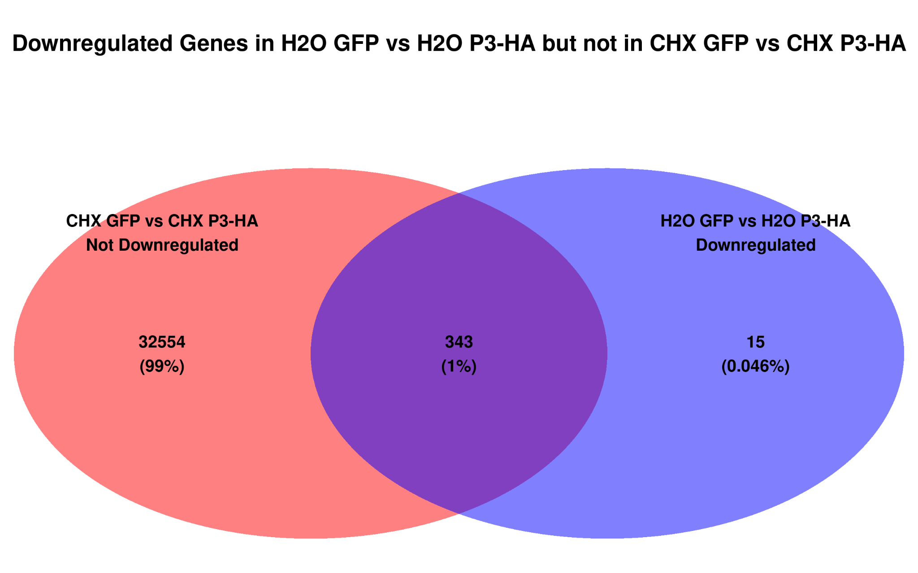
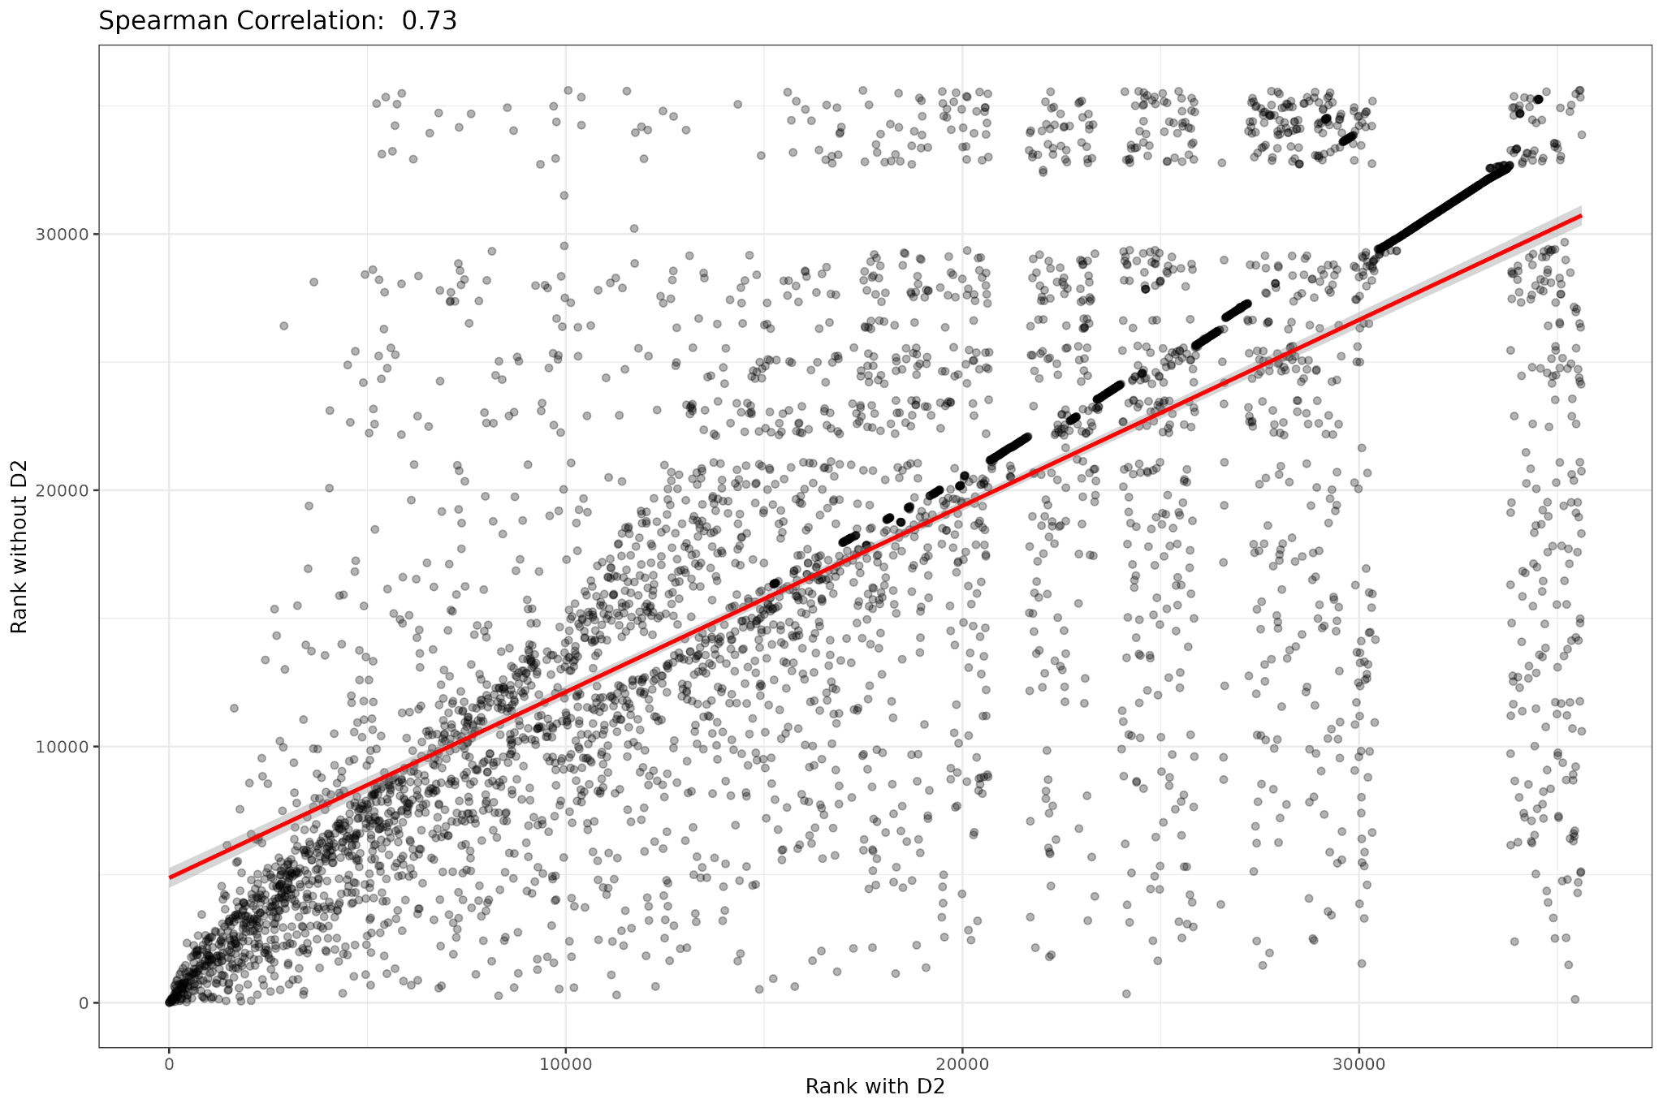
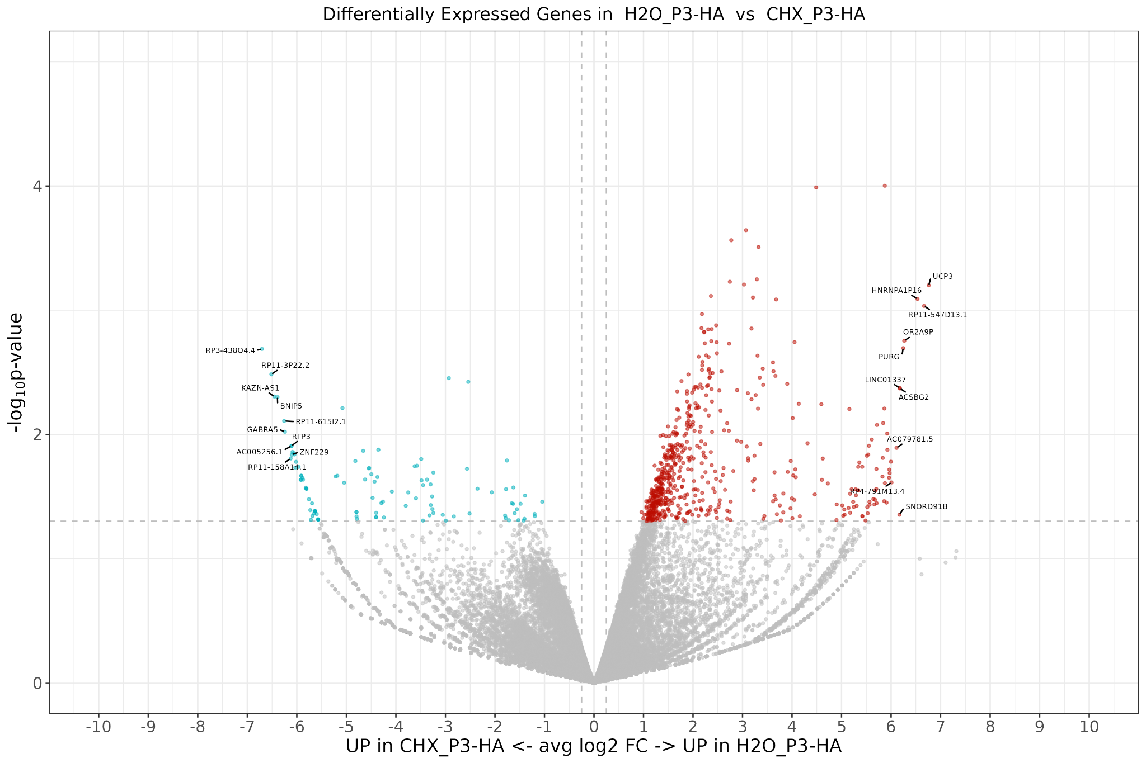
Data Processing Workflow:
Paired end reads data preprocessing→ PCA plots → DESeq2
Visualization:
Volcano plots, Venn Diagram
Spearman Correlation Analysis
Notes:
The creation of a joint table and the comparison across multiple conditions
Contrast: H2O GFP vs H2O P3-HA:
* Significant Genes (p-value < 0.05): 687 genes
* Downregulated Genes: 358 genes
* Significant Genes (p-value < 0.05 and FDR < 0.1): 1 gene
Why Make These Comparisons:
a) Consistency Check:
If a gene is truly downregulated by PAX3, it should show this trend in both H2O and CHX conditions.
This helps rule out false positives due to random variation or sample size effects.
b) Identify PAX3-Specific Effects:
Genes consistently downregulated in P3-HA conditions (both H2O and CHX) are likely direct PAX3 targets.
Paired-End Reads Data:
Start with paired-end RNA-seq data for comprehensive analysis.
Quality Control with FastQC:
Assess the quality of raw sequencing data using FastQC.
STAR Alignment:
Align the quality-checked reads to the reference genome using the STAR aligner.
SAMtools:
Process aligned reads using SAMtools for indexing and sorting.
FeatureCounts:
Quantify gene expression levels from the aligned reads using FeatureCounts.
Check consistency across counts files (e.g., C1_counts.txt.summary and log.final.out). Uniquely mapped reads, successfully alignment counts
PCA Plots:
Perform Principal Component Analysis (PCA) to visualize sample clustering and identify outliers.
DESeq2 Analysis:
Use DESeq2 to identify differentially expressed genes between groups.
Generate volcano plots to visualize differentially expressed genes.
Differential Expression Analysis:
Separate differentially expressed genes into upregulated and downregulated categories.
Create Venn diagrams to compare gene sets across different conditions (e.g., GFP vs. PAX3).
Splicing Analysis: Investigate PAX3's impact on splicing patterns
Investigate splicing events such as intron retention and exon skipping.

Slide 11
Challenges and Approaches in RNA-seq Analysis
PAX3 Function
Traditional view: Transcriptional activator
New perspective: Can also act as repressor
Approach: Include all differentially expressed genes
Upregulated and downregulated
Captures full range of PAX3 effects
Analysis Strategy
Plot all significantly changed genes
Group genes based on:
Up/downregulation
Significance of change
Identify patterns across conditions
Confirm normalization of background noise
Notes:
questions whether PAX3 acts as a transcriptional activator, noting that traditionally it has been seen as one, but it can also function as a repressor. They suggest starting with all genes that show any change, whether upregulated or downregulated, under PAX3 treatment to avoid missing significant findings. This inclusive approach ensures that both activation and repression by PAX3 are considered, recognizing that PAX3's role can vary depending on the context.
include all differentially expressed genes. plotting all genes that show significant changes between the two conditions (GFP vs. PAX3 overexpression) to identify patterns. They suggest creating separate groups based on whether the genes are upregulated or downregulated and whether the changes are significant or not. Speaker 2 predicts that the background noise will be normalized in the experiment design but acknowledges that this needs to be confirmed through analysis.

Slide 12
Challenges and Approaches in RNA-seq Analysis
Normalization
Crucial for accurate analysis
Accounts for:
Sequencing depth differences
RNA composition variations
Technical factors
Improper normalization may lead to misleading results
Notes:
Normalization is crucial in RNA-seq data analysis to account for differences in sequencing depth, RNA composition, and other technical factors between samples.If the data isn't properly normalized, the current representation in your analysis might be misleading.
This could lead to incorrect conclusions about PAX3's effects on gene expression.

Slide 13
Broader Context
The project aims to elucidate the mechanism by which PAX3 influences NMD
It explores both transcriptional and post-transcriptional effects of PAX3
The research could reveal novel insights into gene regulation in the context of diseases like melanoma

